Slide 1
BlockChain Presentation
Olayinka Adelakun

Slide 2
Papers
A Fistful of Bitcoin: Characterizing Payments Among Men with No Names
Tracing Transaction Across Cryptocurrency Ledgers

Slide 3
A Fistful of Bitcoin: Characterizing Payments Among Men with No Names
October 2013

Slide 4
Authors
Sarah Meiklejohn
Marjori Pomarole
Grant Jordan
Kirill Levchenko
Damon McCoy
Geoffrey M.Voelker
Stefan Savage
Notes:
The authors are from two universities, University of California, and George Mason University

Slide 5
Content
Introduction
Bitcoin Background
Data Collection
Account Clustering Heuristics
Service centrality
Related Work
Conclusion

Slide 6
Introduction
The Goal
The goal is to better understand the traceability of Bitcoin flows and, through this understanding and exploring the evolution in how Bitcoin has been used over time.
The Methodology
Re-identification attack
Clustering public keys
Notes:
Speaking on how they derived the goal of this paper it is mentioned that bitcoin’s psuedo-anonymity has limited how much is known about how the currency is used and how bitcoin’s use has evolved overtime.
So the goal is *read from slide *
They describe a re-identification attack wherein they open accounts and make purchases from broad range of known Bitcoin merchants and service providers. Since one endpoint of the transaction is known They are able to positively label the public key on the other end as belonging to the service; Then they augment this attack by crawling Bitcoin forum for self-labeled public keys
They build on previous efforts to cluster public keys based on evidence of shared spending authority. This clustering allows them to amplify the results of their re-identification attack. If they can label one public key as belonging to a user, they can transitively infer that the cluster containing this public key as belonging to user as well. The result of this is a condensed graph in which nodes represent entire users and services rather than public keys
Where this approach differs from other paper, we have seen is that the graph in this project is more condense because of the clustering of user and it is easier to manipulate and derive information

Slide 7
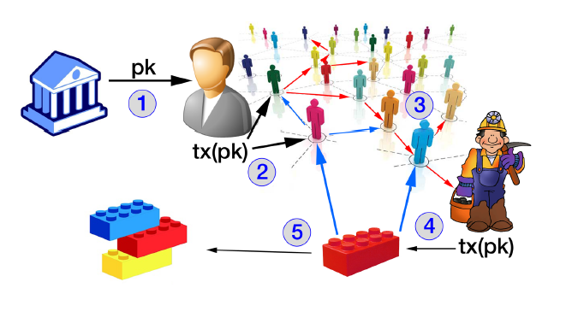
Bitcoin Background
Bitcoin protocol
Creator
Double spending
Validation of the Blockchain
Addresses and its pseudo-anonymity
How transactions are grouped
Proof of work
Notes:
In this section they define the Bitcoin protocol and mention the anonymity that the protocol is intended to provide
They also present a high-level overview of Bitcoin participation and some general statistics about the Bitcoin Network 2013 or earlier.
Bitcoin protocol description
So this section highlights basic information about the Bitcoin most of US ARE ALREADY familiar WITH so i‘m not going to go over that

Slide 8
Bitcoin Background cont.
Bitcoin Participation
Mining pool
Uses of Bitcoin
Gambling (Satoshi dice)
Ecommerce
Investment
Notes:
This section talks about the difficult of mining and how people usually utilize mining pool
This section of the paper talks about the uses of bitcoin

Slide 9
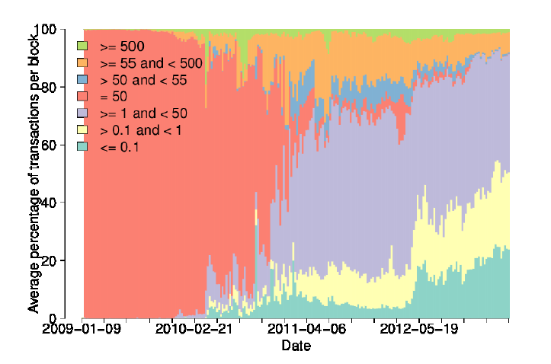
Bitcoin Background cont.
Bitcoin Network Statistics
Transaction structure
Notes:
Where it starts to get interesting is Bitcoin statistics
So using a relational database, the authors parsed the blockchain when there where 231,207 blocks, containing 16,086,73 transactions and 12,056,684 distinct public keys
this graph essentially shows us the transaction structure
Not surprisingly the first 15 month most transactions were rewards of mining so the transaction involved 50 btc, moving forward, these types of transaction became a minority by January 2011. This essentially shows us that bitcoin was in the adoption phase. We see another turning point in 2012 in which the percentage of transactions carrying less than a single btc doubles, while the percentage of transaction carrying less than 0.1 btc tripled

Slide 10
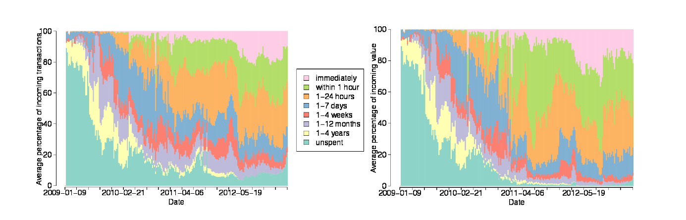
Bitcoin Background cont.
Bitcoin Network Statistics
How quick BTC were spent
Notes:
They also observed how quick btc were spent
In terms of public key and in terms of value
Looking at this figure, we again see two clear turning points. The first, in early 2011, represents a point at which users began meaningfully spending bitcoins, rather than just “hoarding” them; in fact, from this point on a negligible fraction of bitcoins are hoarded
in april 2012 the percentage of bitcoins being spent immediately doubled and more generally half of all bitcoins are now spent within an hour of being received and 80% of bitcoins are spent within a day

Slide 11
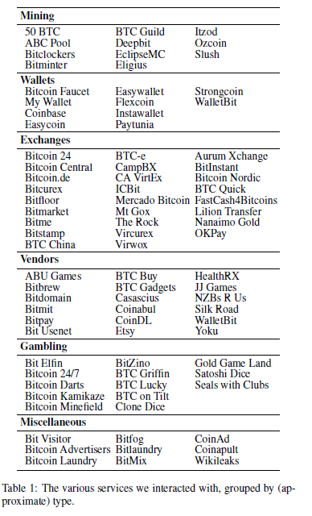
Data Collection
These are the service interacted with to obtain public keys
Notes:
They sought to “tag” as many addresses as possible this means that they label an address as being definitively controlled by some known real-world user. And by tagging it helps us develop a more compact graph for analysis
So engaged in 344 transactions in all the services you see listed on the screen
The services range from mining to wallet to Gambing

Slide 12
Account Clustering Heuristic
Heuristic 1
Grouping public keys used as inputs to a transaction as being controlled by the same user
Heuristic 2
Is based on change addresses
Notes:
The first heuristic one is where they treat different public keys used as inputs to a transaction as being controlled by the same user. So, the paper a controller of an address is an entity that is expected to participate in transactions involving that address
The second is new and based on change addresses;

Slide 13
Account Clustering Heuristic cont.
Heuristic 1 explained
If two or more public keys are used as inputs to the same transaction, then we say that they are controlled by the same user.
The effect of this Heuristic are transitive
Using this heuristic we decreased the users considered by 54%
Notes:
If two or more public keys are used as inputs to the same transaction, then we say that they are controlled by the same user. That is for any transaction t all public key in input(t) are controlled by the same user
The effects of this heuristic are transitive and extend well beyond the inputs to a single transaction. This means that if we observed one transaction with addresses A and B as inputs, and another with addresses B and C as inputs, then we conclude A B and C all belonged to the same user.
Using this heuristic we partitioned the network into 5,579,176 clusters of users that is almost 54% of less of the value we started with

Slide 14
Account Clustering Heuristic cont.
Heuristic 2 explained
Change address are the mechanism used to give money back to the input user in a transaction as bitcoin can only be divided by being sent.
What this heuristic is saying is that we can cluster input address and change addresses as long as we can identify the change address.
This heuristic lacks robustness
Notes:
Change address are the mechanism used to give money back to the input user in a transaction as bitcoin can only be divided by being sent. What this heuristic is saying is that we can cluster input addresses and change addresses as long as we can identify the change address.
Working of the assumption that a change address has only one input they initially look at the outputs of every transaction.
If only one of the outputs met this pattern, then they identified that output as the change address. If, however, multiple outputs only one input and thus the change address were ambiguous, they did not label any change address for that transaction. We also avoided certain transactions like in a coin generation or Coinbase transaction, none of the outputs are change addresses.
This heuristic lack robustness in the face of changing patterns. It has a negative consequence which is falsely linking even a small number of change addresses might collapse the entire graph into a large super cluster
It was notice that most of the false positives where coming Satoshi dice
and the false positive rate were down to about 0.17% after waiting a week
Two issues that forced redefining of Heuristic 2
Change address were being used twice, if the change address is used the second time with a new address the new address would be falsely labelled as a change address.
Address would be used as a “self-change address” and then also used as a change address
Result this heuristic space produced about four million clusters and of these clusters 2000 of them were named

Slide 15
Service Centrality
Potential issues of the privacy of Bitcoin
Notes:
So this section of the paper identifies that Bitcoin services mentioned earlier(like satoshi dice) are somewhat centralized and it makes the argument that these services make it difficult for highly motivated individuals to stay completely anonymous provided they interested in converting Bitcoin to Fiat money
For criminals, this centrality presents a unique problem: if a thief steals thousands of bitcoins, this theft is unavoidably visible within the Bitcoin network, and thus the initial address of the thief is known and he cannot simply transfer the bitcoins directly from the exchange.
On of the movement criminals uses is known as peeling chain. In a peeling chain, a single address begins with a relatively large number of bitcoins. A smaller amount is then “peeled” off this larger amount, creating a transaction in which a small amount is transferred to one address and the remainder is transferred to a one-time change address. This process is repeated—potentially for hundreds or thousands of hops—until the larger amount is pared down, at which point (in one usage) the amount remain. The is one of the movement but he used untested heuristic to on and found promising results about Silk Road

Slide 16
Conclusion
They developed new clustering heuristics based on change address and Heuristic 1 to better cluster users
Using transaction that were tagged they identify interactions between clusters/user
With this experiment it is easy to see that light has been shed on the structure of the Bitcoin economy

Slide 17
Questions
Addresses that are specified as bad addresses, where are they usually stored and what happens to the owners
This paper was written in 2013, since then are there now ways that users can utilize that such an algorithm would not be able to pick up transactions and decrease anonymity

Slide 18
Tracing Transactions Across Cryptocurrency Ledger
May 2019

Slide 19
Authors
Haaroon Yousaf
George Kappos
Sarah Meiklejohn
Notes:
The authors are from the University College London

Slide 20
Content
Introduction
Related Work
Background
Data Collection and Statistics
Tracing Cross-Currency Activity
Clustering Analysis
Pattern of Shapeshift Usage
Conclusion

Slide 21
Introduction
The Goal
Exploration of the usage of cross currency trading platform and the potential they offer in terms of ability to track flow of coins as they move across different transaction ledgers.
The Data
Data from Cryptocurrency blockchain
Data collected via their own interactions with the trading platforms
The information offered by platforms themselves via public APIs
Notes:
it is well established that the usage of pseudo-anonymity in Bitcoin doesn’t achieve meaningful level of anonymity and casts a doubt on its role as it a payment form
The ability to track flow of coins is not limited to Bitcoin it is also extended to privacy coins like Dash Monero and Zcash that incorporates features that are designed to improve on bitcoins anonymity
Criminals attempting to cash out illicit funds would have to use exchange. Nowadays however exchange typically implements strict know your customer policies to comply with regulatory requirements meaning criminals risk revealing their real identities when using them.
users also run risk when storing their coins in accounts of custodial exchange as exchanges may be hacked or the coins may otherwise become inaccessible
As an alternative that emerged in the past few years frictionless trading platforms such as shapeshift and changelly in which users are able to trade between cryptocurrencies without having to store their coins with platform providers.
The goal of the paper is to

Slide 22
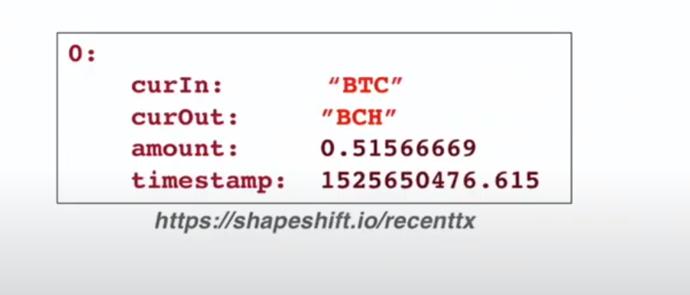
Background
A digital asset trading platform
Notes:
A digital asset trading platform allows users to move between different crypto currencies without storing any money in an account with this service
in other words, users keep their own money in their own account and the platform has it's only at the time that the trade is being executed
to initiate such a trade the user approaches the services selects the supported input currency and supported output currency that they would like
the user Additionally specifies a destination address which is the address in which the output currency would be sent
So, what happens is the user then sends this address the amount in currIn they wish to convert and the service sends the appropriate amount of the output currency to the specified destination address this means that an interaction with these services results in two transactions one on the currIn blockchain sending amounts to address and one on the CurrOut blockchain sending rates times amount
The Image on the right shows the output of a shifting from one currency to another I felt like it was going to be good to be able to see what these values mean and what it returns

Slide 23
Data Collection and Statistics
Changelly and Shapeshift
API specification
The current trading rates
50 of the most recent transaction that have taken place
Full details of a specific shapeshift transaction given the address in the currin blockchain
using a simple web scraper, they downloaded transactions an drates every 5 seconds for close to 13 months from November 2017 to December 2018 this resulted in this set of almost 3 million distinct transaction
Notes:
so the paper identifies the two major digital asset trading platforms changelly and shapeshift. It mentions that both trading platforms took a while carry out transactions because of the fact that both platforms were trying to protect from double spending.
Read first point
For the trading rates it provided the CurrIn an Currout. the rate, the limits which is the maximum that can be exchanged the minimum that can be exchanged and the mining fee
Read second point
For the 50 most recent transactions information is provided in the form of currin, currout, amounts, Unix timestamp and ID which resembles the image I showed on the previous page
Read third point
when provided with the specified address she returns the status which is a flag that is either completes or error, the address, withdraw, in coin, in type, out coin, out type, transaction, transaction URL and error

Slide 24
Identifying BlockChain Transactions
An interaction with shapeshift results in the deposit of coins from the user to the service on the curIn blockchain which they refer to as phase one
They consider two requirements for identifying the correct on-chain transaction
That it occurred reasonably comfortable close in time to the point at which it was advertised via the API.
That the value it carried was identical to the advertiser amount
and the withdrawal of coins from the service to the user on the curOut blockchain is phase 2
Notes:
This section presents heuristics for identifying these on-chain transaction
Read point
they seek to identified the deposit transaction on the inputs blockchain to do this
Read sub point
Reading sub sub point one
given a shapeshift transaction with timestamp T they first find the block on the currIn blockchain that was mined at the time closest to t.
They look at both earlier and later blocks based on the observation in their own interactions with the timestamps published by shapeshift
to rule out false positives they considered as successful only shapeshift transaction with a single candidate on chain transactions then they use the value of two parameters to maximize the number of single hit transactions for each currency
In order to validate the results of their heuristic for phase 1 they use the additional capability of shapeshift API.
So what they do is they query the API with the recipient's address of every transaction identifier by their heuristic for phase one
if the response of the API was affirmative, they flagged the recipient addresses belonging to shapeshift
and they identified the transaction in which it receives coins as CurIn transaction.
this also provides a way to identify the corresponding phase two transaction on the CurOut blockchain as it is just the transaction field returned from the API
so, in other words, the method serves not only to validate but also provides a way to identify CurOut transaction

Slide 25
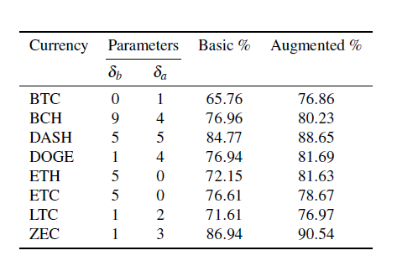
Identifying BlockChain Transactions
Using the validation of the API it can be easily seen on the augument column that the API give an added benefit
Notes:
To Decrease the value of false positives they make sure that the pair of currencies are similar the amount being center similar and the timing interval a similar if not the discarded transaction

Slide 26
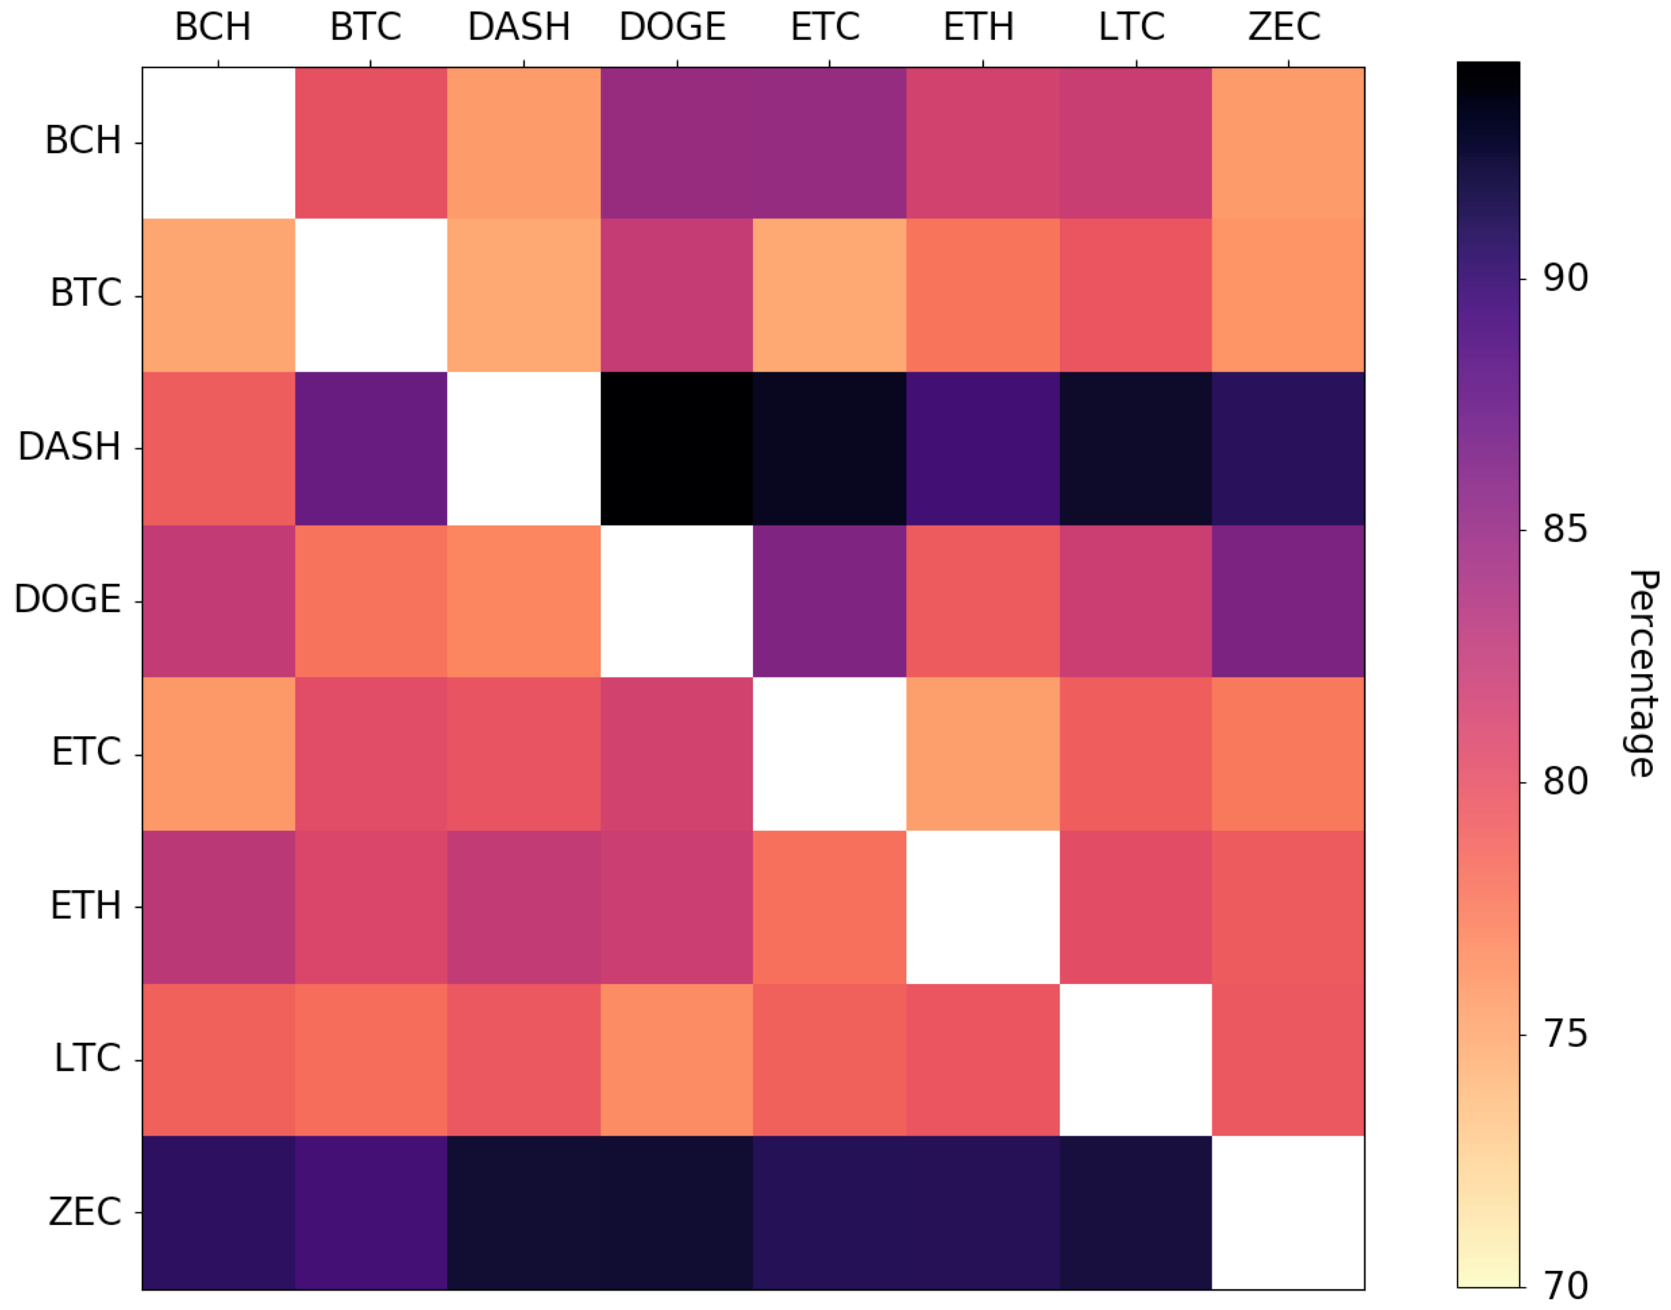
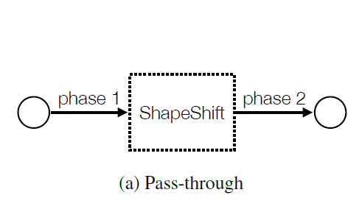
Tracking Cross-Currency Activity
Pass-through Transaction
Pass through transactions represent the full flow of money as it moves from one currency to another via the deposit and withdraw transaction
Notes:
In particular their goal is to test the validity of the implicit assumption made by criminal usage of the platform that shapeshift provides additional anonymity beyond simply transacting in a given currency
Identifying pass through transaction allows us to create a link between the input addresses in a deposit in the curIn blockchain and the output address in the withdrawal on the curOut blockchain
Read slide
the diagram in the center essentially shows that they were typically least successful in blockchains with higher transactional volumes such as bitcoins and Ethereum because of the higher hits number

Slide 27
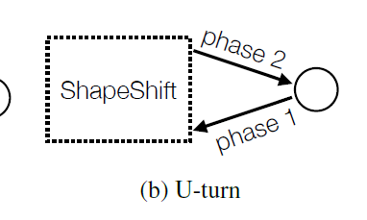
Tracking Cross-Currency Activity cont.
U-turn transaction
U- turn occurs when a user who has shifted into one currency immediately shifts back
2nd transaction happens within 30 minutes of the 1st
Uses the same coin or address between shifts
Notes:
identifying U- turn allows us to see when the user has interacted with shapeshift now because they are interested in holding units of the coral currency but because they see other benefits shooting coins back and forth
U- turn in which a user who has shifted into one currency immediately shifts back
We consider U-turn to be a pattern in which a user just sends money from currin to curout only to turn around and go immediately back to currin. In terms of timing and amount we require that the second transaction happens within 30 minutes of the 1st and that it carries within 1% of the value that was generated in the 1st phase two 2 transaction
In account based cryptocurrencies such as Ethereum they had no choice but to look at addresses. They Define a U-turn if the address that was defined as the output in phase 2 transaction is used as an input in the later phase one transaction and then they run the augmented heuristic to identify relevant output address in the curout blockchain according to the initial transaction one then run the same heuristic to identify relevant input address in the curout blockchain this time according to transaction 2

Slide 28
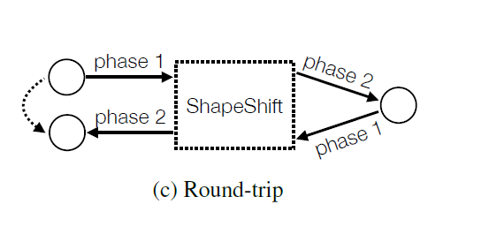
Tracking Cross-Currency Activity cont.
Round trip
Round trip transaction which are essentially a combination the first 2 and follow a user's flow of money as it moves from one currency to another and then back to the original 1
Advantage over U-turn: identity of the initiator is known
Notes:
identifying roundtrip transactions allows us to create a link between the input address in the deposit on the curve in blockchain with the output addresses in the little withdrawal on the car in blockchain
The roundtrip transaction requires performing through shapeshift transaction one out of the initial currency and one back into it to identify roundtrip transactions we effectively combine the result of pass through and you turn transaction

Slide 29
Clustering Analysis
Common social relationship
if two or more addresses send coins to the same address in the curOut blockchain or if two or more addresses receive coins from the same address in the curIn blockchain then these addresses have some common social relationship

Slide 30
Pattern of Shapeshift Usage
Anonymity in private cryptocurrencies
Notes:
this section describes how the usage of private crypto currency is motivated by the anonymity
The anonymity feature in Zcash is known as shielded pool. When putting money in the pool the recipient is specified using the Z address which hides the recipients and reveals the sender and taking money out of the pool hide the sender but reveals the recipient. Z cash is designed to provide privacy mainly in the case in which users transact within the shielded pool which hides the sender recipient and the value being sent

Slide 31
Conclusion
Focusing on the ability to link together their ledgers of multiple different cryptocurrency to accomplish this task they looked at trading platforms with the technique they develop that it is possible to capture complex transactional behaviors and trace their activities even as it moves across ledgers which has implications for any criminal attempting to use the platform to obscure the flow of their money
Notes:
To conclude

Slide 32
Questions
Since the Heuristic matches transactions would there be a way that people can disguise transactions, and make them look like normal transaction so the number of hit go up and the algorithm won’t be able identify those transaction

